Slide 1
Utility
Funding level

Slide 2

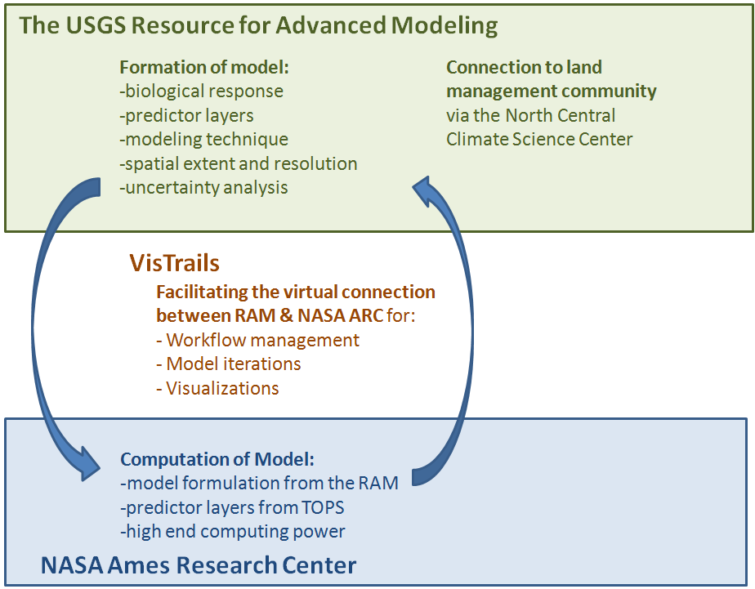




Using the USGS “Resource for Advanced Modeling” to connect climate drivers to biological response
Jeff Morisette/USGS, Petr Votova/Ames, Claudio Silva/NYU Poly
Notes:
The Figure on the left shows the main components of the project. The main concept is utilize both data and computational capacity available at NASA Ames to improve the accuracy and speed of models formulated at the USGS Resource for Advanced Modeling. The interaction between the RAM and Ames will be facilitated by the VisTrails software. The connection to the land management community will come through the interaction with CSU and the North Central Climate Science Center.
The graphic on the right represents the impetus for the project. The USGS holds, within the RAM, the field data and modeling code. Many of the predictor layers used in the RAM come from NASA or could be generated within the NASA Ames TOPS project. So, instead of trying to bring all the predictor layers into the RAM, why not send the field data and model code to Ames? The project will work toward running the model in the most efficient and effective location.

Slide 3
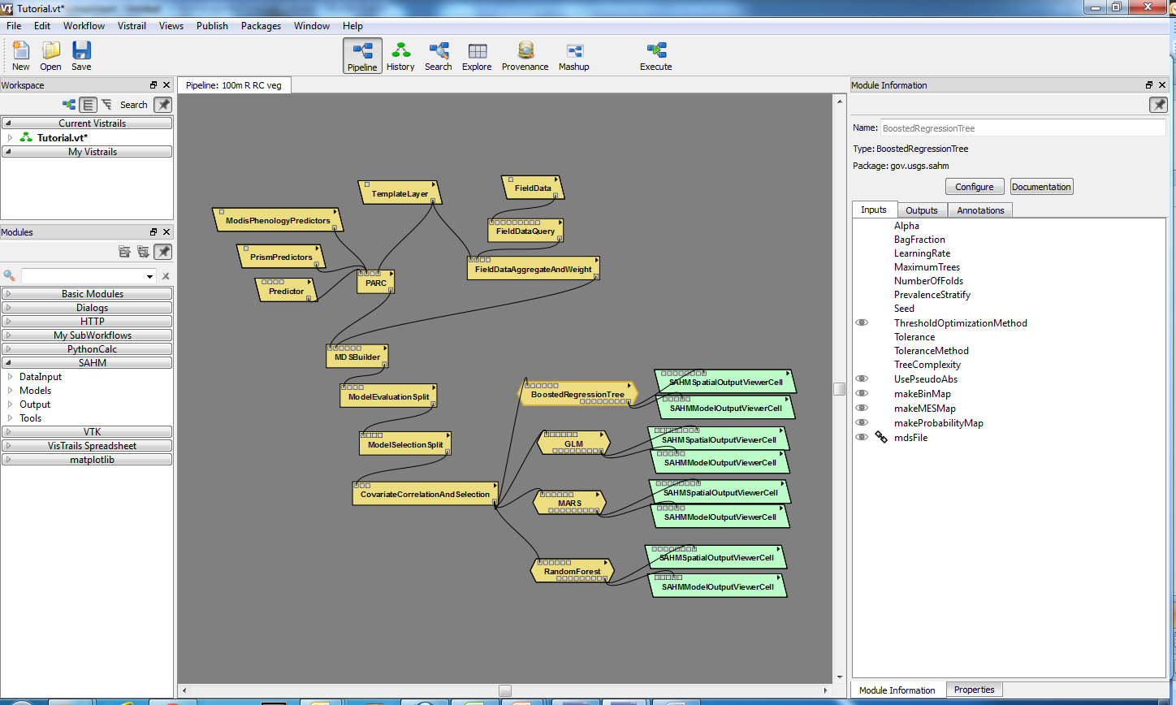
Morisette et al., in review, “VisTrails SAHM: visualization and workflow management for species habitat modeling”, Ecography.
Notes:
Formalization and tractable recording of the entire modeling process
allows for easier collaboration
file management and compatibility burden on researchers is greatly reduced
Future/additional modeling routines and tools “easily” added as new modules

Slide 4
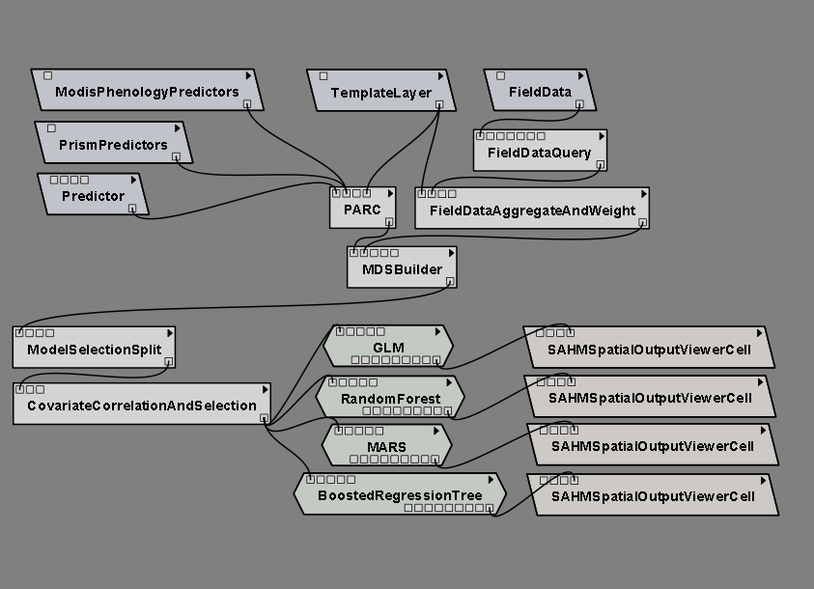
Input data
Preprocessing
Preliminary model
analysis & decision
Correlative models
Output routines

Slide 5
Hijmans et al, 2005, “ Very High Resolution Interpolated Climate Surfaces for Global Land Areas”, Int. J. Climatol., 25: 1965-1978.
Notes:
Hijmans et al, 2005, “ Very High Resolution Interpolated Climate Surfaces for Global Land Areas”, Int. J. Climatol., 25: 1965-1978.

Slide 6
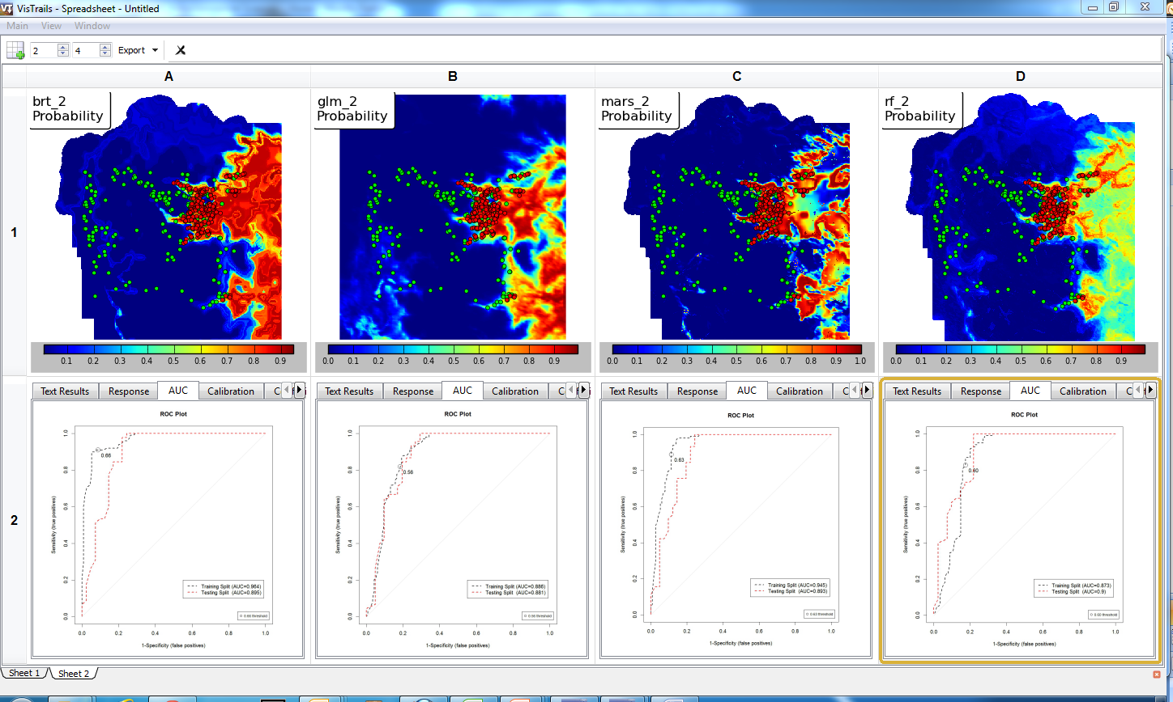

Slide 7
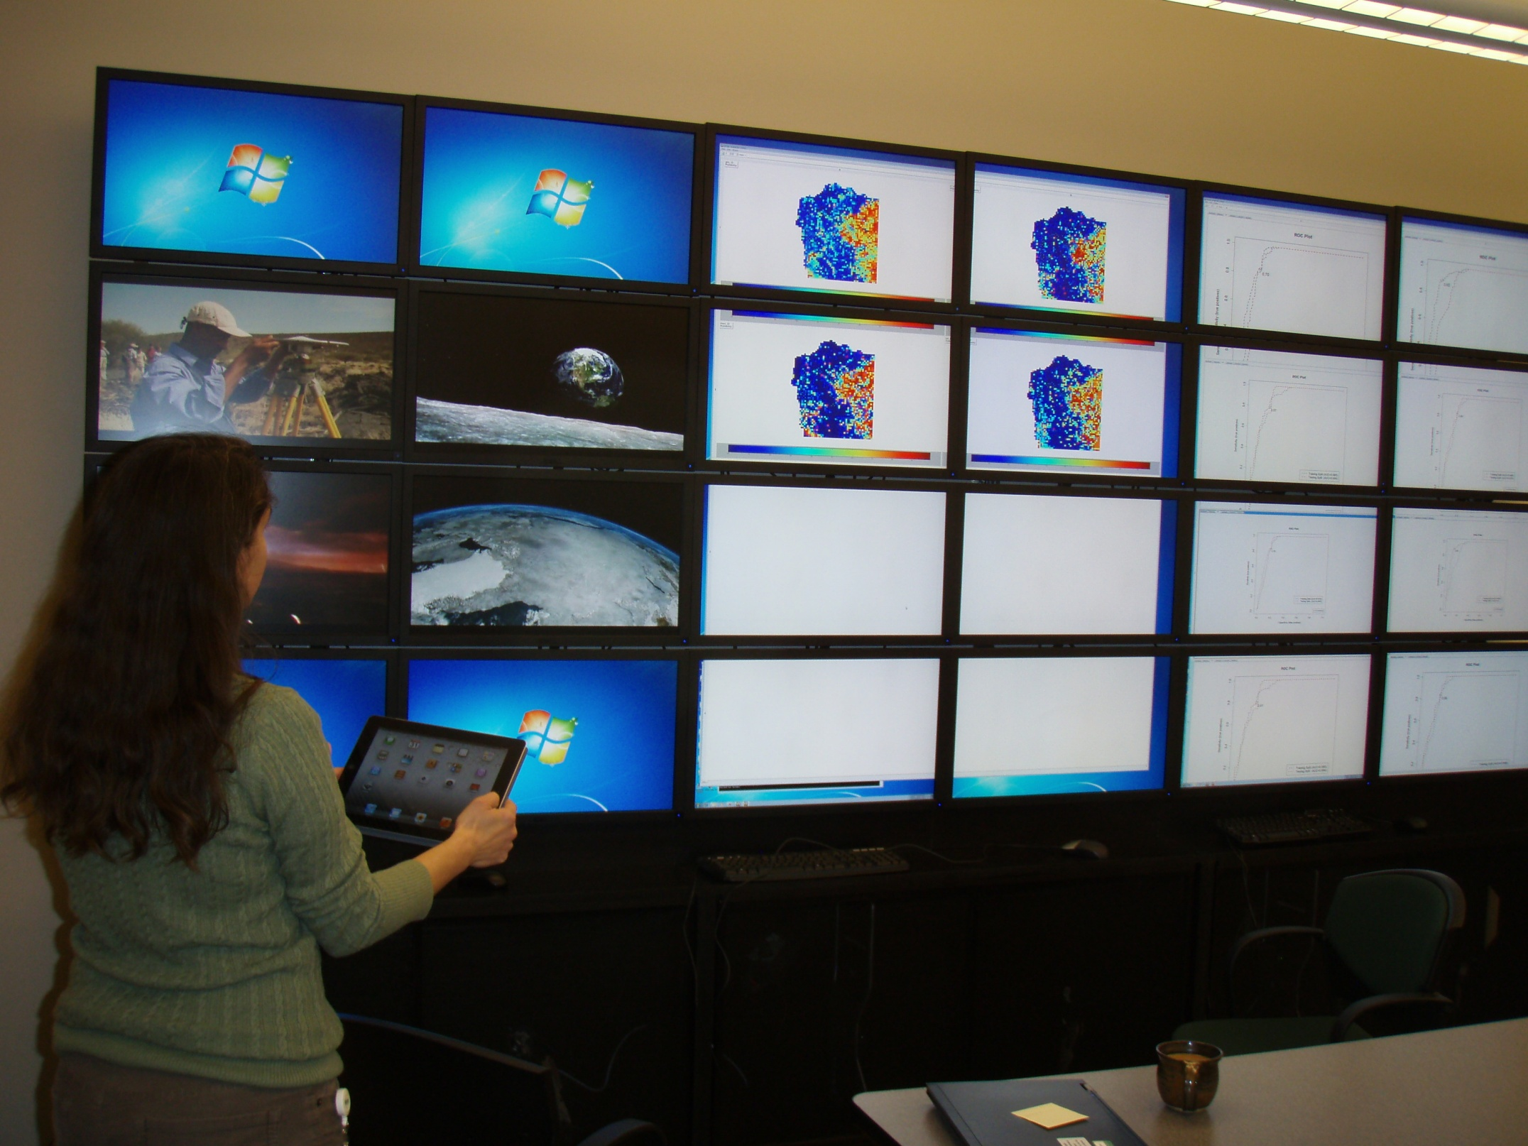

Slide 8

Notes:
This document can be used to help put our work in the context of what is being taught and practices by DOI land managers.

Slide 9
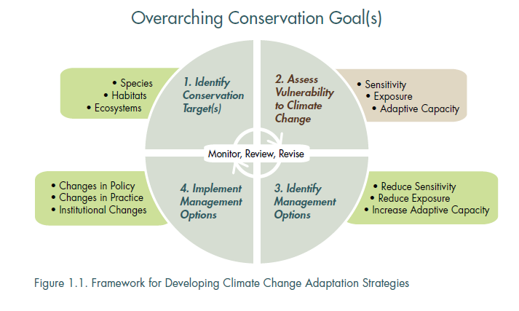
In space and time
Notes:
Target:
Species, habitat, ecosystem (service)
In a defined space and time
Start with the end user in mind
Audience
Objective/concerns
Decision constraints
Benefits:
Provide data
Refine scope and focus
Sociopolitical context
Build support for adaptation

Slide 10
North Central
Climate Science Center
Landscape Cons.Coop
& other stakeholders
Notes:
Target:
Species, habitat, ecosystem (service)
In a defined space and time
Start with the end user in mind
Audience
Objective/concerns
Decision constraints
Benefits:
Provide data
Refine scope and focus
Sociopolitical context
Build support for adaptation

Slide 11
Resistance
Sensitivity
Resilience
Exposure
Transition
Potential
Impact
Adaptive
Capacity
Vulnerability
Notes:
Consider better figures (see Matt’s talk for URL resources)
Orange: intrinsic to system
Blue: extrinsic
Green: often based on human expectations.

Slide 12
Re source for
Vulnerability Assessment,
Adaptation, and
Mitigation
Planning

Slide 13
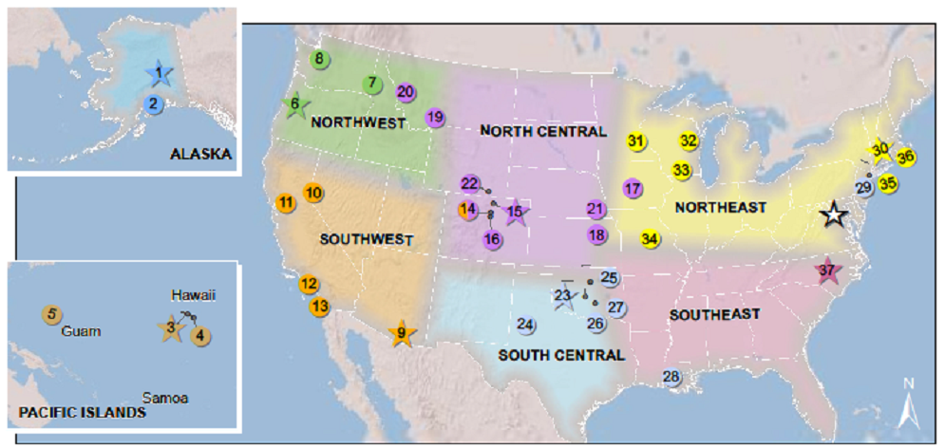
Notes:
2010: Alask, Northwest, Southeast
2011: Southwest and North Central
2012: Pacific, South Central, Northeast
Regions have “fuzzy boundaries” to accommodate biological realities and not be tied to a single geographic frame
No single set of lines will work for every conservation challenge
Climate change will have large regional expression, and the regions here will face common changes and resource conditions.
Our goal is to not let them get in the way of doing business.

Slide 14
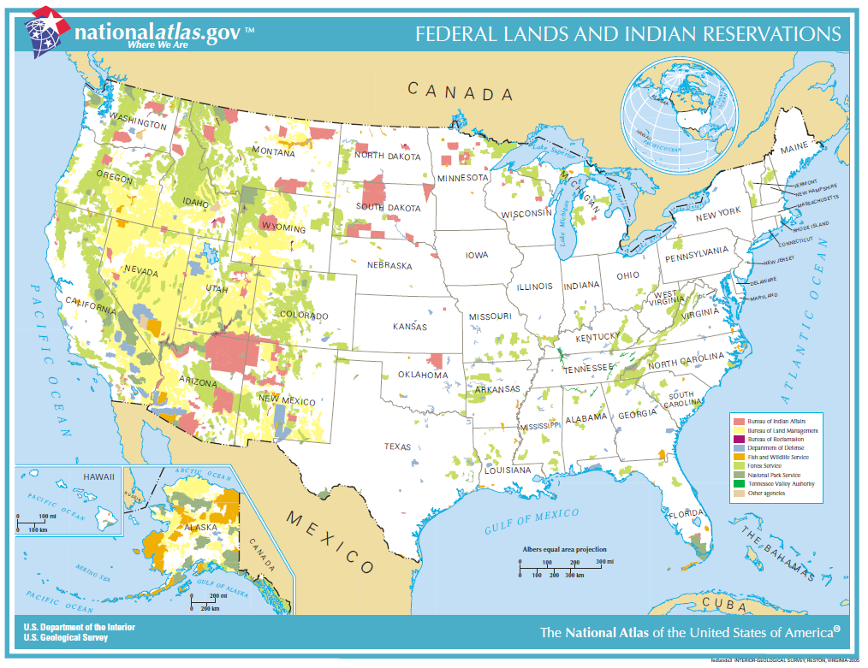
Notes:
The Federal Government owns nearly 650 million acres of land - almost 30 percent of the land area of the United States.
Department of Interior manages roughly 500 million acres. There are only 13 countries with more TOTAL land. If all DOI land was its own country, it would be at the 94th percentile for land area.

Slide 15
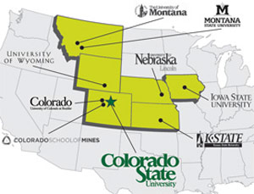
North Central Climate Science Center
University Consortium

Slide 16
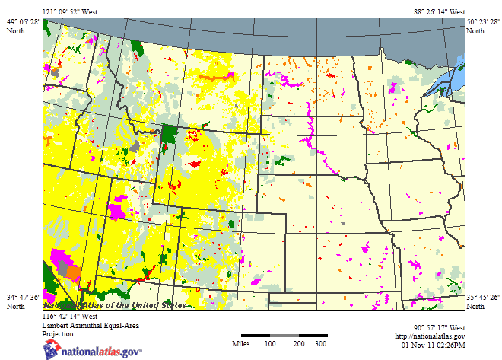
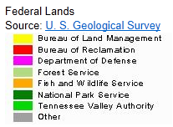
North Central CSC domain
Notes:
Kansas, Nebraska, South Dakota, North Dakota, Colorado, Wyoming, Montana.

Slide 17
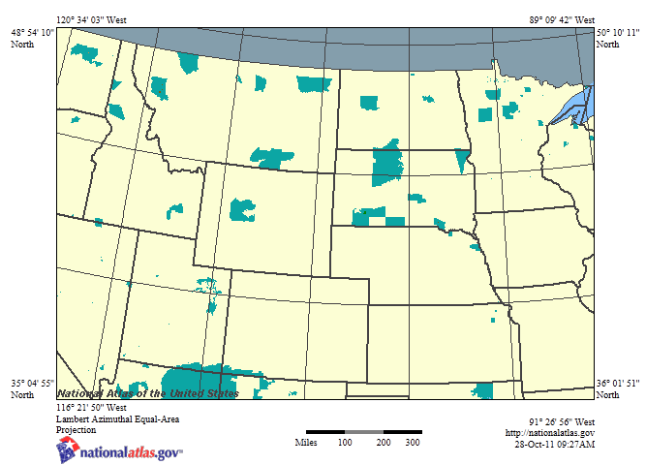
Native American Lands
Notes:
Dennis and Jay have included tribal nations in the NC CSC planning.
Gary Collins, wind river, 2M acres:
“tribal nation are finally at the table, not on the menu”
Consider having CSCs at SACNAS (the Society for the Advancement of Chicanos and Native Americans in the Sciences)

Slide 18
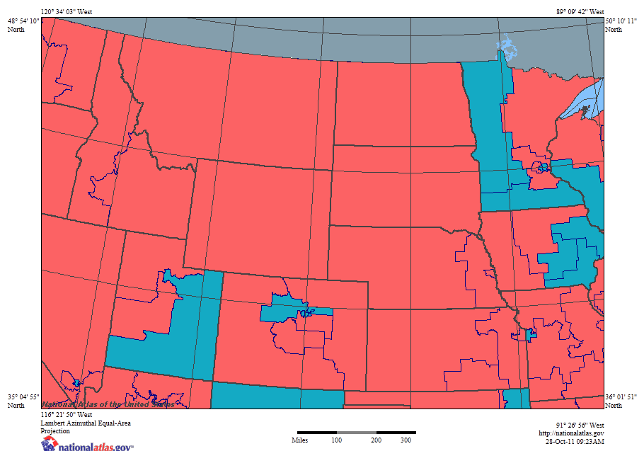
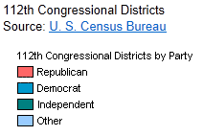



112th Congressional Districts
Image represents senate parties.
Notes:
We need to focus on current or near-term issues that are important to both parties.

Slide 19
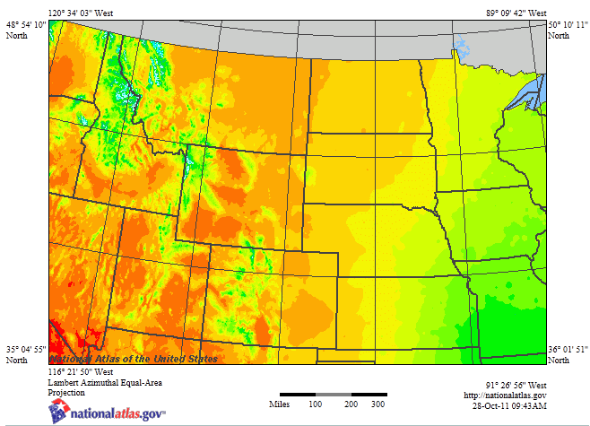
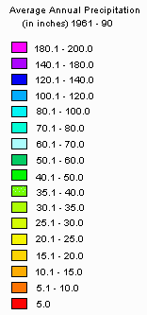
Average Annual Precipitation 1961-1990

Slide 20
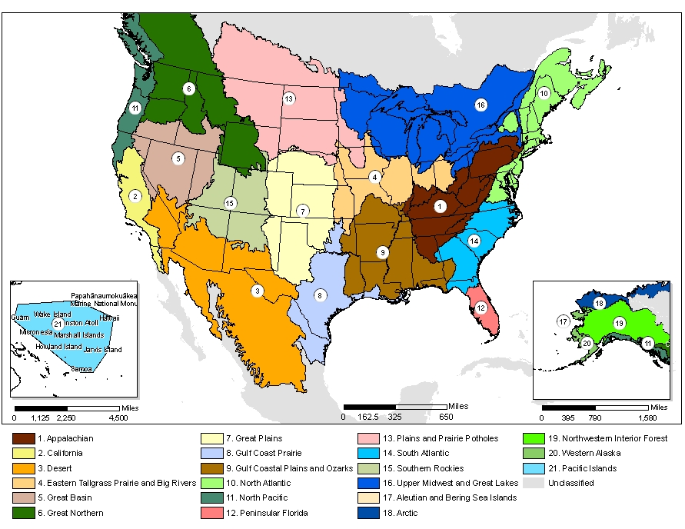
Notes:
LCCs “…will work interactively with the relevant DOI Climate Science Center(s) and help coordinate adaptation efforts in the region.”
LCCs are the “primary partners” for CSCs
Their management-driven science needs are critical drivers of CSC science
LCCs are represented on CSC Stakeholder Advisory Committee (SAC), and CSCs are LCC Steering Committees
CSC – SAC merges individual LCC and agency priorities into a regional agenda
CSC scientists will work directly with LCC and other management partners as the science is conducted

Slide 21
North Central
Climate Science Center
Landscape Cons.Coop
& other stakeholders
Notes:
Target:
Species, habitat, ecosystem (service)
In a defined space and time
Start with the end user in mind
Audience
Objective/concerns
Decision constraints
Benefits:
Provide data
Refine scope and focus
Sociopolitical context
Build support for adaptation

